Slide 1
Memory and Cognition 422
Chapter 1 History

Slide 2
What percent?
What percent of our brains do you think we use?
  Ok now stick your fingers in your ears and close your eyes.
  You’re still using almost all of your brain.

Slide 3
Why are we here?
Cognitive Psychology
  Study of the thinking mind
Why?
  Scientists are cats. (Curiosity)
  We like to show off. (Other Research)
  Or get paid a lot. (Applications).

Slide 4
Why is erin here?
3 things:
  Psychology is a science, especially the cognition field.
  We don’t like to think hard.
  We like new shiny things.

Slide 5
History of Cognition
And some other interesting stuff.
Chapter 1

Slide 6
In the beginning…
Descartes, Locke, etc.
Psychology started as a philosophy.

Slide 7
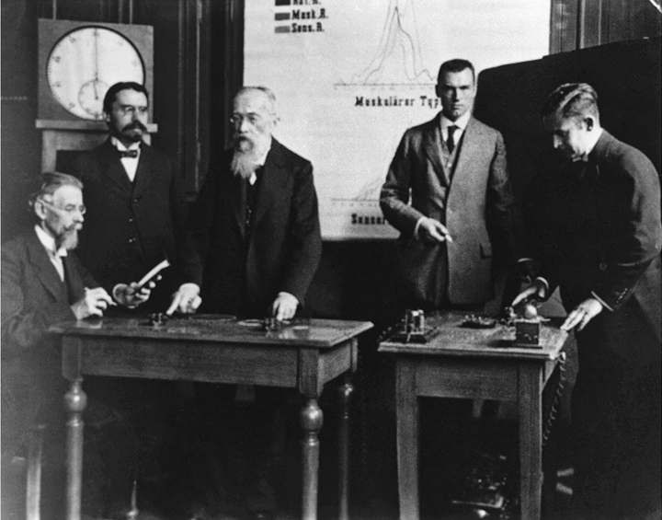
In the Beginning: The Contents of Consciousness
Wilhelm Wundt (1832–1920) : headed the first modern psychology laboratory in 1879, in Leipzig, Germany.
Introspection: the process of internal perception, that is, looking within oneself to assess one’s mental activity.
Edward Titchener (1867–1927): an American student of Wundt’s who extended this approach to cover not only sensations and feelings but all mental activity.
Chapter 1
Notes:
Wilhelm Wundt (1832–1920), who focused on under­standing the nature of consciousness (Figure 1–1). Wundt’s guiding idea was that the contents of consciousness—the things we are aware of—can be approached by analogy to the way chemists approach the structure of molecules: (1) by characterizing basic sensations (such as feeling heat or cold, or seeing red or blue) and feelings (such as fear and love), and (2) by finding the rules whereby such elements are combined (such as the ways simple sensations are combined to form the perception of seeing an entire object, with its shape, texture, and color). (p. 4)

Slide 8
In the Beginning: The Contents of Consciousness
Wundt’s school made at least two major contributions:
(1) They showed that mental activity can be broken down into more basic operations.
(2) They developed objective methods for assessing mental activity.
Did they rely too heavily on introspection?*
Chapter 1
Notes:
*Try to answer this question: What shape are a cat’s ears? Most people report that they visualize the animal’s head and “look” at its ears. Did you have this experience? Not everyone does. What can we conclude when people disagree about their introspections? And now consider what color were the ears, what texture? Were these characteristics present in your mental image? Are you sure? What do we do when people who report on their own mental activity aren’t certain?

Slide 9
Psychology in the World
William James (1842–1910): focused not on the nature of mental activity, but rather on the functions of specific mental activities in the world.
The functionalist perspective: certain practices or approaches are better suited than others to accomplishing certain tasks, and that we should change our thoughts and be­havior as we discover those that are increasingly “better adapted” to our environment.
It relied in large part on ideas about evolution proposed by Charles Darwin.
Chapter 1
Notes:
At about the same time that Wundt’s laboratory was up and running, another approach to scientific psychology was developed, primarily in America, by William James (1842–1910).

Slide 10
Thinking is bogus!
Behaviorism
  Hull, Skinner, Watson, etc.
Notes:
Can’t see this thinking thing, so how do we measure it? We can’t so it doesn’t exist.

Slide 11
Behaviorism: Reaction against the Unobservable
Clark L. Hull (1884–1952): proposed that internal events that are inferred directly from behavior such as motivation, even though these events we
re not themselves immediately observable.
B. F. Skinner (1904–1990): went so far as to reject absolutely all discussion of internal events.
Behaviorists limits:
It simply could not explain the most interesting human behaviors, notably language (Chomsky, 1957, 1959). (p. 7)
Failed to provide insights into the nature of perception,
Chapter 1
Notes:
The early psychologists sensibly tried to model their new science on the success stories of the day, the methods of physics, chemistry, and biology. But different psy­chologists took different lessons from the successes of other sciences, and some declared that psychology should not attempt to understand hidden mental events but rather should focus purely on the immediately observable: stimuli, responses, and the consequences of those responses. (p. 6)

Slide 12
Revolt!
Cognition was a reaction to behaviorism.
  Birth of Cognitive Science: 1957 MIT symposium
The Military
  Broadbent, Garner, Miller
Miller’s Magic Number (1956)

Slide 13
The Cognitive Revolution
This new approach, developed in the late 1950s and early 1960s, was directly tied to the development of the computer (Gardner, 1985). (p. 8)
Researchers seized on the computer as a model for the way in which human mental activity takes place; the computer was a tool that allowed researchers to specify the internal mechanisms that produce behavior.
Herbert A. Simon and Alan Newell and linguist Noam Chomsky played a central role in this revolution, providing examples of how progress could be achieved by comparing the mind to a computing machine.
Chapter 1

Slide 14
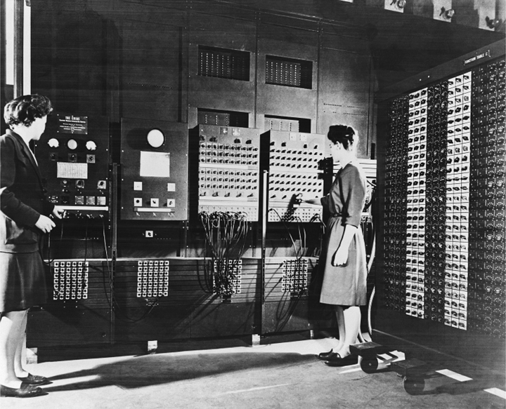
BINAC: the Binary Automatic Computer, developed in 1949
Chapter 1
Notes:
The cognitive revolution blossomed when researchers developed new methods to test predictions from computational models, which often specified the order in which specific mental activities purportedly take place. These methods were an im­portant part of the cognitive revolution because they allowed mental activity to be studied more objectively than did introspection, thereby allowing many researchers

Slide 15
Artificial Intelligence
Newell and Simon
Using computers to simulate mind
What’s the point of AI?
Notes:
Won the nobel prize in economics for research in decision making.

Slide 16
AI Research
Human Research
Get some data
Can a computer do it?
Wonkiness
Do people do that?

Slide 17
Theories

Slide 18
Understanding the Mind: The Form of Theories of Cognition
Mind and Brain
Mental Representation
Mental Processing
Why the Brain?
Chapter 1
Notes:
The cognitive revolution led to a detailed conception of the form of a theory of men­tal activity, but to say that mental activities are like computer programs is a leap. Consider the machines that run computer programs versus the “machine” that pro­duces mental activity—that is, the brain. Certainly, computers and brains look very different and are composed of different materials. Moreover, computer programs are separate from the computers that run them; the same program can run on many dif­ferent machines. But the mental activities taking place in your head right now are yours and yours alone. Why should we assume that programs for computers have anything to do with mental activities produced by brains? Clearly the analogy is re­stricted to only certain aspects of computer programs. But which ones? (p. 9)

Slide 19
Mind-Brain Connection
Are they really separate?
Levels of analysis
  Physiological (neurons)
  Mental (thinking)
Information processing approach
  Storage, manipulation, and transformation of information.
Notes:
So we’ve been using the computer analogy - is the mind software and the brain hardware?
Not really separate - they are just different levels of analysis
These two compliment each other

Slide 20
Mental Representation
A representation is a physical state (such as marks on a page, magnetic fields in a computer, or neural connections in a brain) that conveys information, specifying an object, event, or category or its characteristics.
Representations have two distinct facets:
(1) Format: the means by which it conveys information.
(2) Content: the meaning, conveyed by a particular representation.
Chapter 1
Notes:
All our mental activity is about something—a possible job you could choose, a friend’s face you see across the way, fond thoughts of last night’s date. Cognitive psy­chologists try to specify how information is internally represented. (p. 11)

Slide 21
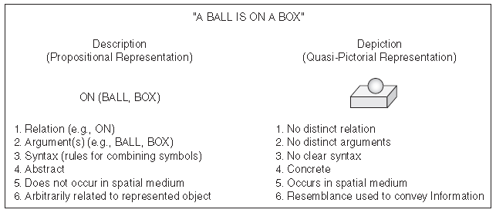
Mental Representation
The same content can be represented either by descriptions (abstract, language-like propositional representations) or depictions (picture-like representations). Some of the differences between the two types of formats are listed. A “relation” specifies how entities are combined, and an “argument” is an entity that is affected by a relation.
(Adapted and reprinted with permission of the publisher from Image and Mind by Stephen M. Kosslyn, p. 31, Cambridge, Mass: Harvard University Press, Copyright © 1980 by the President and Fellows of Harvard College.)
Chapter 1

Slide 22
Mental Processing
A process is a transformation of information that obeys well-defined principles to produce a specific output when given a specific input.
A processing system is a set of processes that work together to accomplish a type of task, using and producing representations as appropriate.
An algorithm is a step-by-step procedure that guarantees that a certain input will produce a certain output.
Chapter 1
Notes:
Does a tree falling in the forest make a sound if nobody is there to hear it? The an­swer, at least for psychologists, is clear: no. “Sound” is a psychological quality, which is not the same thing as compressed air waves. A brain must be present in or­der to register the pattern of compression in the waves, and it is the neural impulses in the brain that give rise to our experience of sound. No brain, no sound. (p. 11)

Slide 23
That’s great, but…
Bejebus, how is this science?!
So, how do we test this thinking thing?

Slide 24
Experiments are neat.
Looking for causal relationships between things.
  How do we make this causal?
    Well, you have to manipulate variables.
  What happens when you can’t do that? (ethics)
    Correlational studies – covered more in the brain section.

Slide 25
Parts of Neat
Independent variables (IVs)
  Manipulated factors (often a grouping variable, like experimental and control groups)
Dependent variables (DVs)
  Measured factors
Extraneous variables (3rd variables)
  “Noise”

Slide 26
The Point
Cognitive psychology is a science, which is tested through experiments.
These experiments lead to theories, which lead to more experiments.
Why should we care?
  Business, Military, Computers, Advertising, etc. all use this research.

